Slide 1
Week 4
Databases

Slide 2
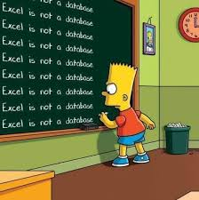
What is a database
A database is a collection of information
Databases store and organize data so you can get to it easier
Databases are good for larger amounts of data
Some examples of where a database might be useful
Customer information
Product or store information
Item collection information (Pokémon, Movies, Books)
Patient records
Student records

Slide 3
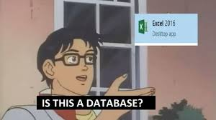
How is a database different then a spreadsheet
Both are tools to store and organize data
Spreadsheets are better for calculations and data entry
Databases are better for manipulating data, running reports and updating data
Databases can also handle larger amounts of data more easily than a spreadsheet
Databases are also better if there are multiple people that need access to the data, especially if the access needs are simultaneous
SPREADSHEETS ARE NOT DATABASES

Slide 4
Structured vs Unstructured data
Structured Data | Unstructured Data
Organized and formatted | Not organized or formatted
Version control can be applied in multiples ways and over parts of the data | Version control can only be done as a whole
Queries are permitted | Only text queries can be used

Slide 5
Why structured data is important
Structured data is typically quantitative and is formatted in specific ways to be more readable for humans and machines.
Structured data is easier to run ML (Machine Learning) Algorithms against
Easier for people to manipulate and analyze the data without needing to understand much about data tyles
More tools are available for structured data
Structured data is generally found in spreadsheets and databases

Slide 6
What is CSV and why do we use it
CSV means Comma Separate values
There are other ways to sperate out the data such as tab, space, semicolon or colon, the symbol used to separate out the values is called a delimiter
It's a text file that allows us to send data in plain text while keeping it organized into tables
CSVs are very useful for getting data from one place to another, such as from a spreadsheet into a database
CSV is not proprietary so it's also a good way to share data between programs that use proprietary formats
Several programs also use CSV for long term data storage as it's fast, readable, and comparatively small.

Slide 7
Why we have databases
Databases allow us to store more data easier than other formats, they also allow us to organize the data in lots of ways
Organized data allows us to run reports and queries more easily, so we can answer certain questions about our data
What is the email address for the customer? How many units did they buy last month? Last year? How much product have we sold last month? Last year?
Databases allow us to store and process our data, but also allow multiple simulations other people to also store and process data
Centralized locations for data to ensure everyone is using the same data and has access to it allows for better business practices

Slide 8
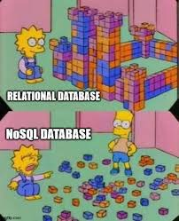
Examples of kinds of databases
Relational
Hierarchical
Non-relational
3D
Geographic
Object Oriented

Slide 9

Relational databases
Organizes data in rows and columns to form tables
Data is structured across multiple tables
Tables are connected (or relate) to each other using primary or foreign keys
We can have multiple relationships or connections between the tables
For example, if you have a customer table, and a products table, and a sales table, you may be able to ask who purchased what, how much, and when

Slide 10

SQL and mySQL
SQL or Structured Query Language is how you interact with a relational database
SQL is the language
MySQL is the database
Might hear S Q L
Might hear See-quil (or sequel)
The language is used to ask questions of your database

